Slide 1
Instructions
Open a terminal and type:
git clone http://github.com/DrPaulSharp/pydantic_workshop.git
cd pydantic_workshop
python –v venv pydantic_workshop
pip install –r requirements.txt
Open your favourite editor and get ready to code!

Slide 2



Pydantic: A Package for Picky Python Programmers
Paul Sharp
ISIS Research Software Engineering Team
December 2023
@DrPaulSharp
Notes:
The abstract pattern can be removed or repositioned if required. Be careful to ‘Send to Back’ so that it does not obscure any important information.

Slide 3


About Me
PhD at University of York 2011-2015.
Postdoc at University of Liverpool, 2016-2020.
Worked at STFC since 2020, first with Scientific Computing & SuperSTEM . . .
. . . and now as a RSE at ISIS Neutron & Muon Source.
Codes:
ChemDASH, InverSTEM, RAT
Notes:
Please replace photo of presenter with a portrait of your own. 1) Send the geometric shape overlay to the back – Right-Click > Send to Back > Send to Back. 2) Replace image – use the guides provided to correctly position it. 3) Send your portrait to the back so that the geometric overlay re-appears over the portrait.

Slide 4


Notes:
To edit the background image, select ‘Format’ from the PowerPoint menu and ‘Slide Background’ from the drop-down menu. Within the new list of options that appears on the right of the screen, select the ‘File’ button under ‘Insert picture from’ and select your image from your file browser. Please remove or amend the image credit if you are using a different image to the one provided.

Slide 5
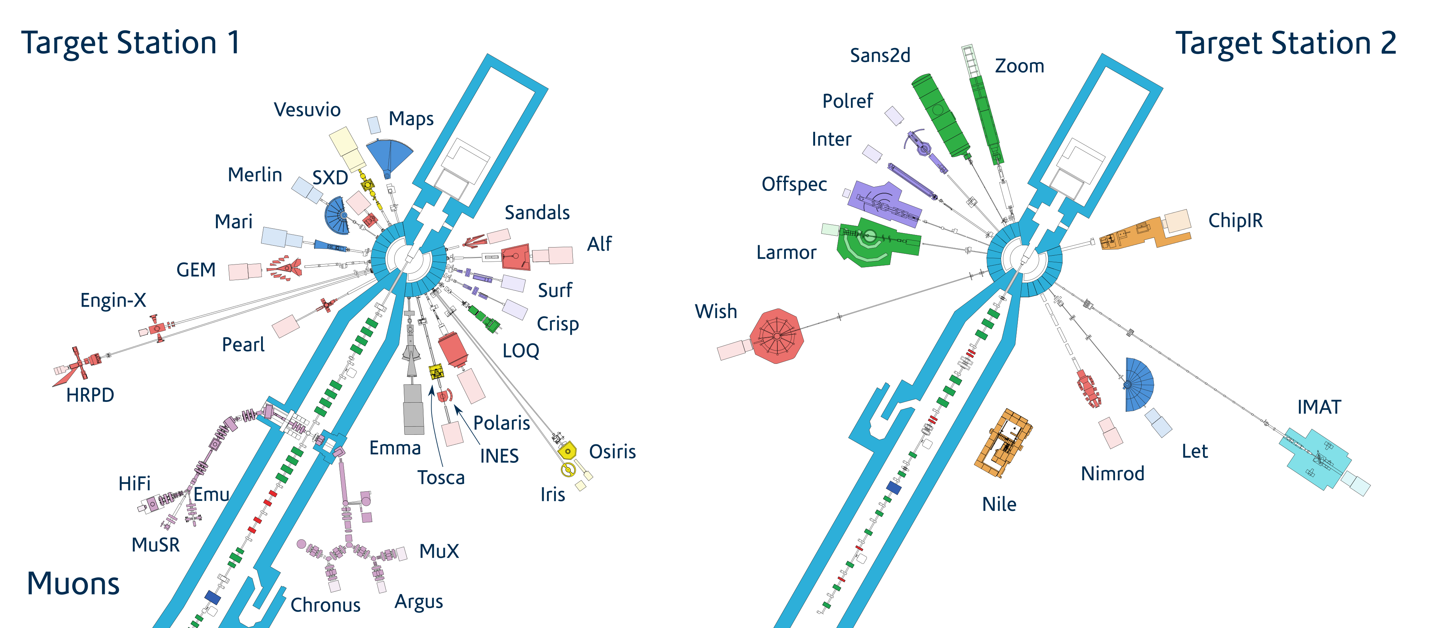

Slide 6
Research Software Engineering
The term “Research Software Engineer” (RSE) was first coined in 2012.
This was done with the aim of promoting the role of software developers in scientific research and to establish a viable career path.
First RSE workshop in 2013, where the RSE association was established. First RSE conference in 2016.
RSE groups have been established in academic institutions and large-scale facilities.

Slide 7
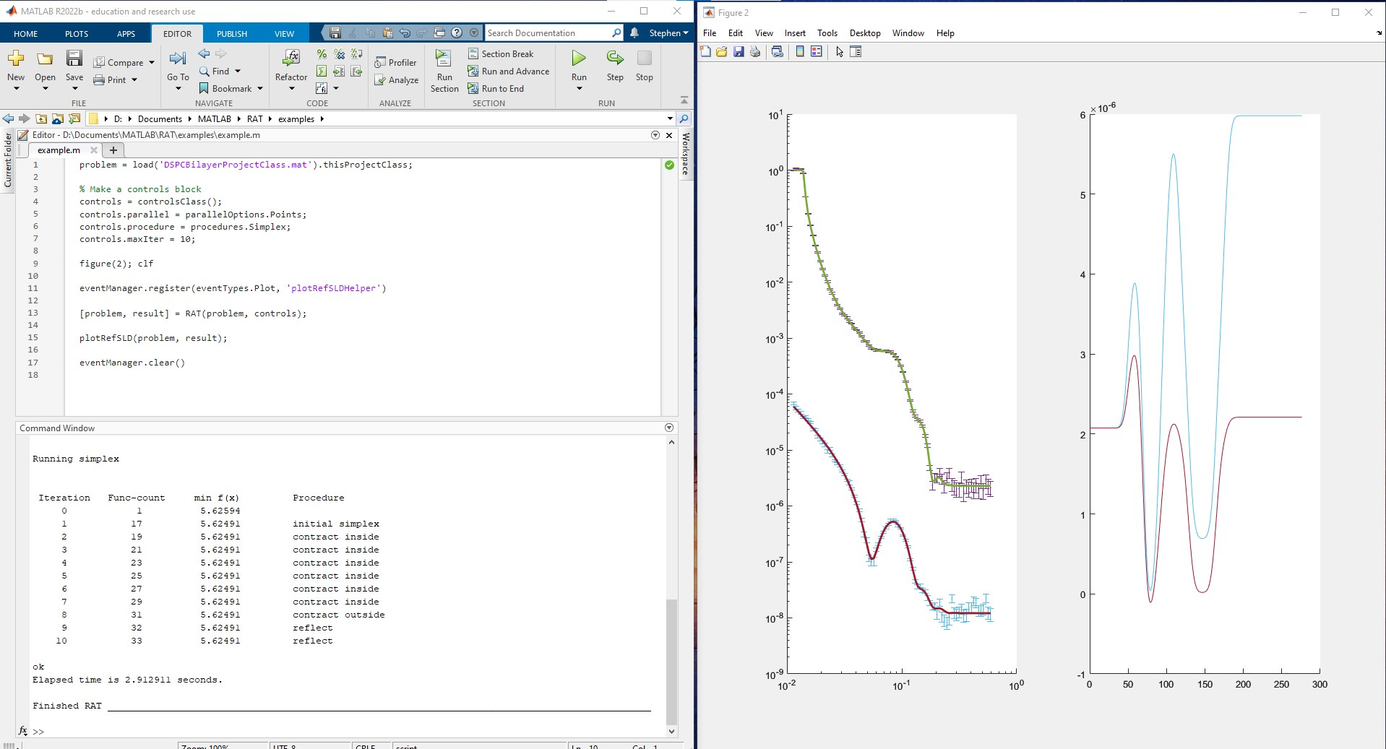
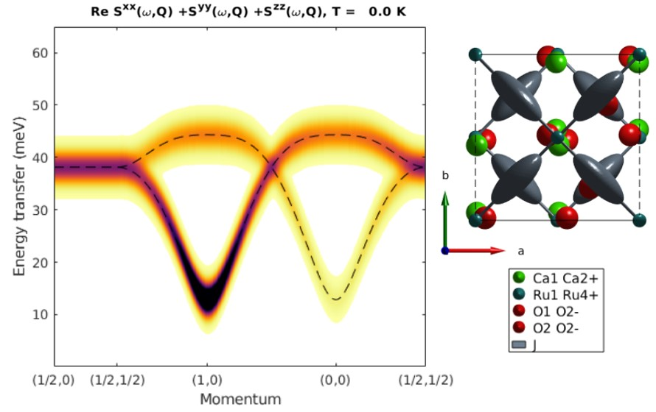
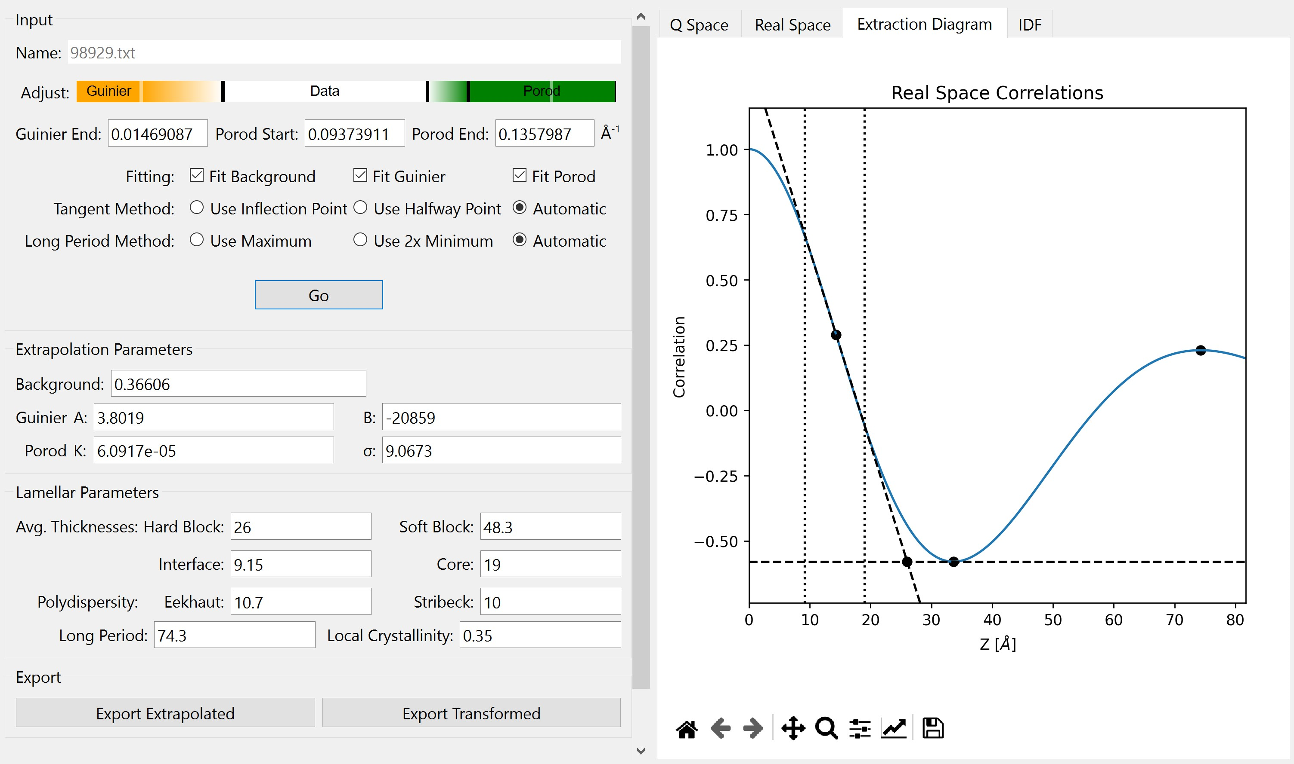
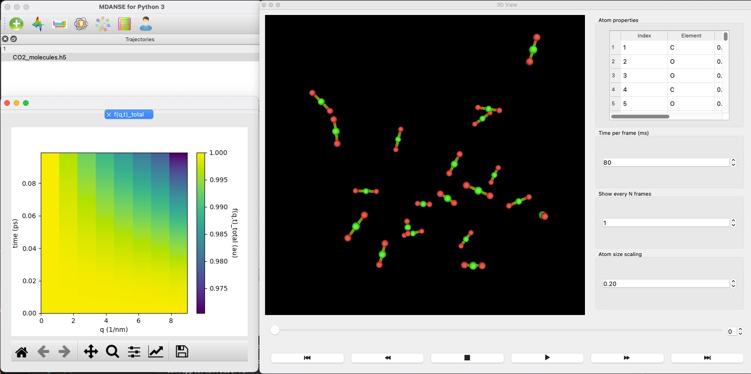
RAT/Rascal
SpinW
SASView
MDANSE

Slide 8
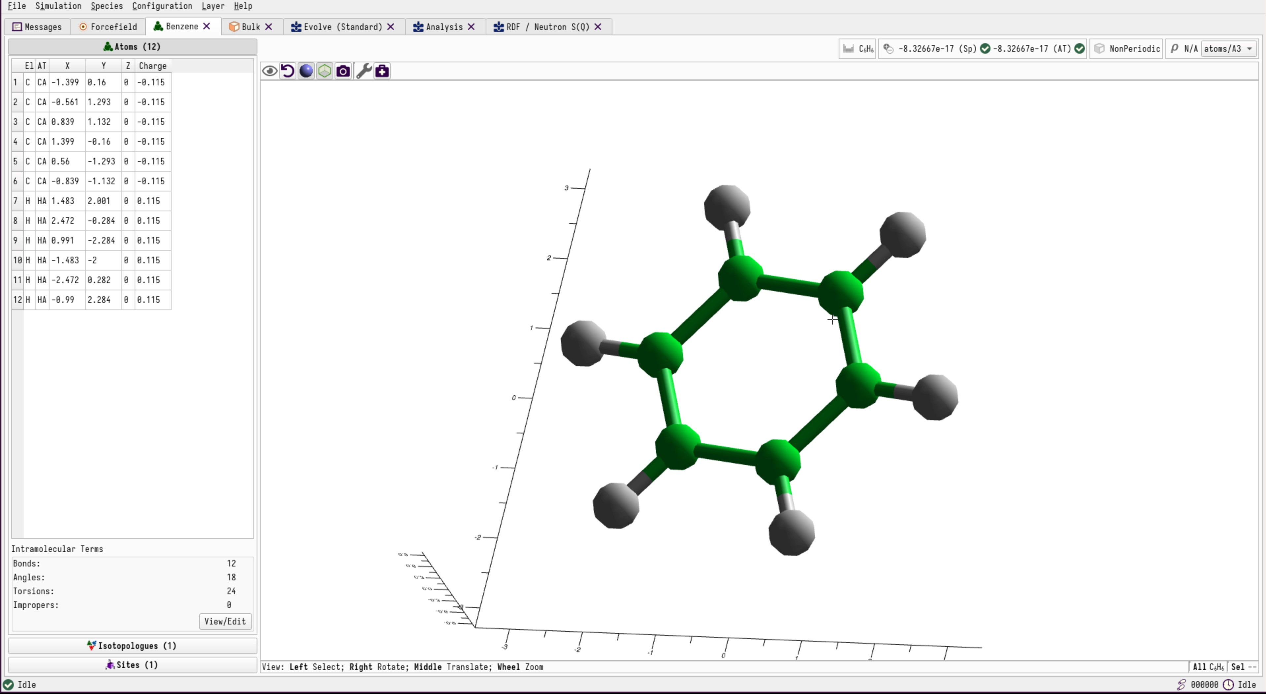
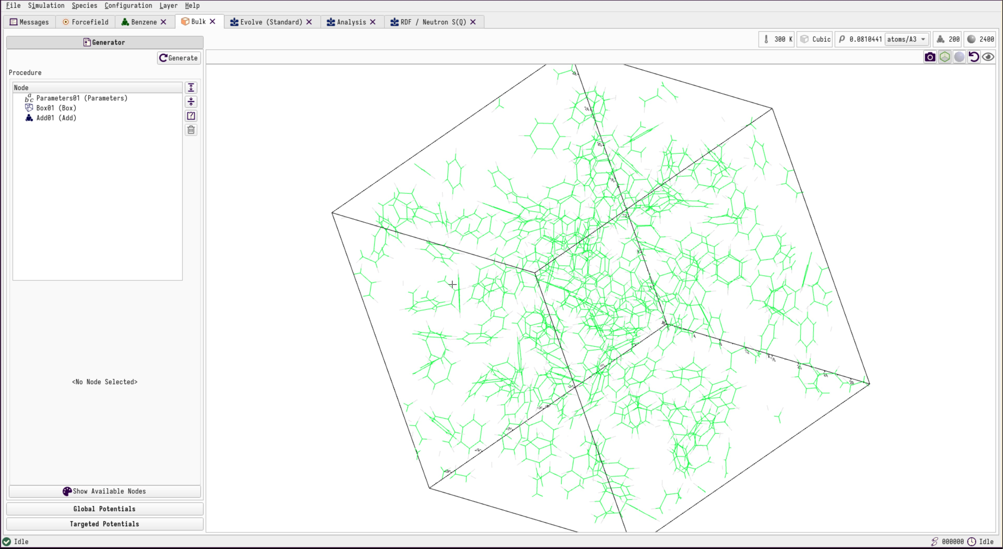
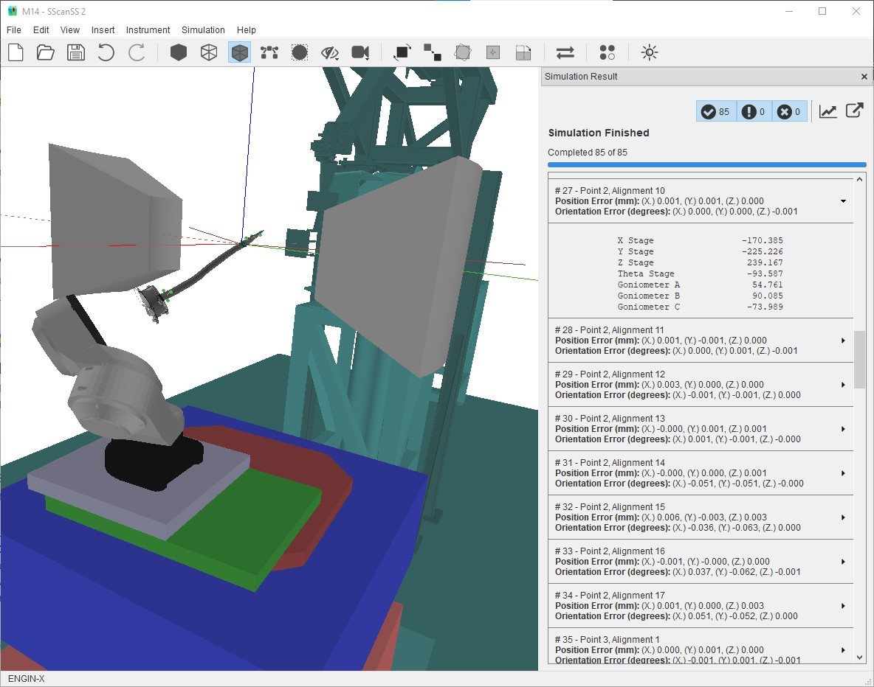
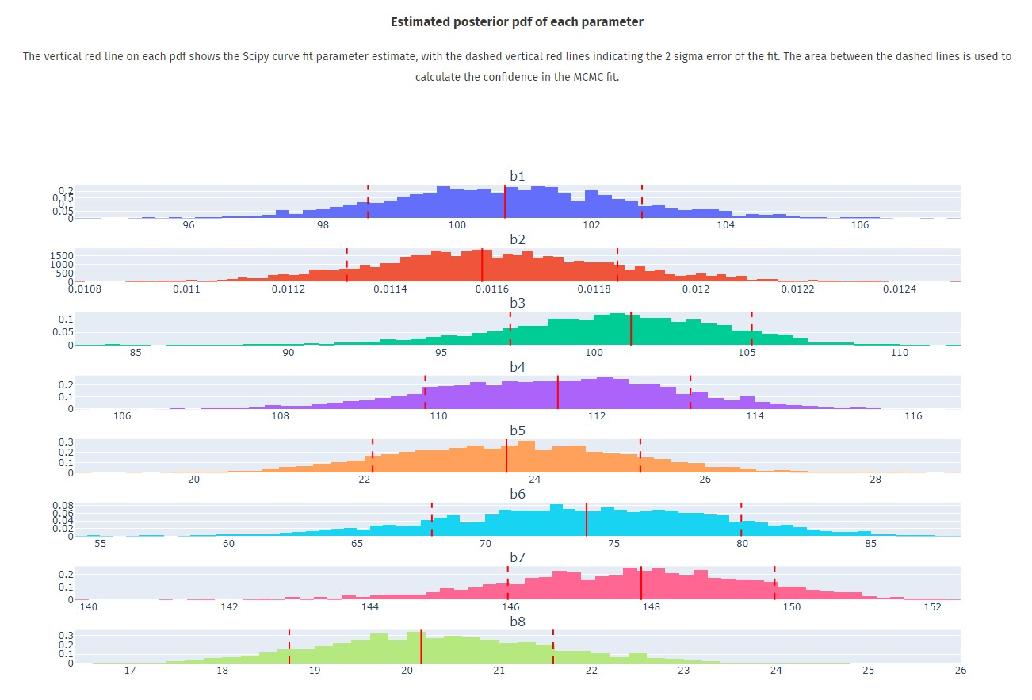
Dissolve
Dissolve
SScanSS-2
FitBenchmarking

Slide 9
Pydantic
Pydantic is the most widely used data validation library for python.
Pydantic is powered by type hints, so data can be defined in pure canonical python 3.7+ and validated with Pydantic.
Pydantic models also share many similarities with Python’s dataclasses.
The docs are available here: https://docs.pydantic.dev/latest/

Slide 10
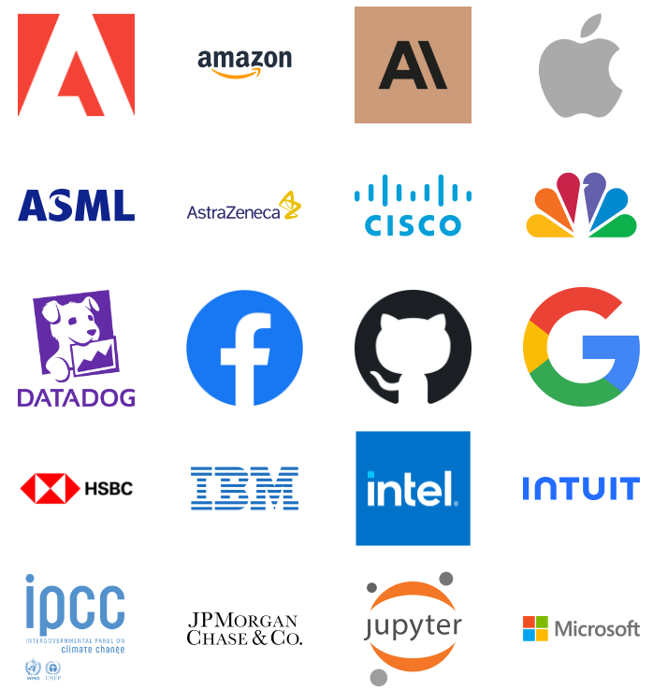
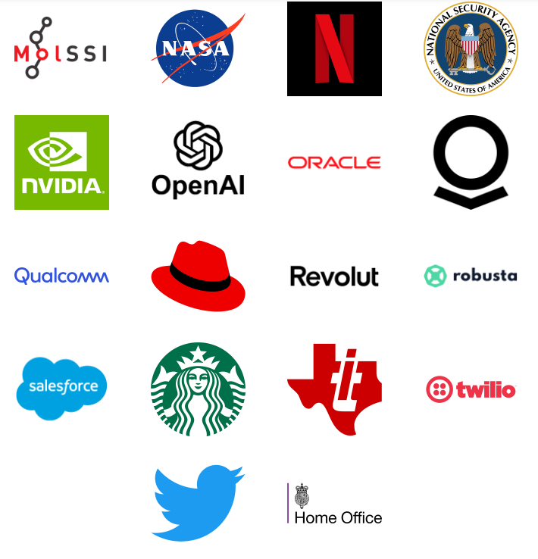
Pydantic
Pydantic is downloaded 123M times a month, and used by some of the largest and most recognisable organisations in the world, including:

Slide 11

Version 2 or Not Version 2?
Pydantic version 2 was released in June 2023.
Always use version 2+ !
Version 2 introduced a considerable number of changes to the syntax and methods, meaning some examples will be out of date.
Version 2 is also 4x-50x faster than version 1.9.1.
Use the migration guide to ensure everything is up to date: https://docs.pydantic.dev/2.0/migration/
Image ©Royal Shakespeare Company

Slide 12
Type Hinting
Python is dynamically typed – so types of variables are determined only at runtime, and the type of a variable is allowed to change over its lifetime.
PEP 484 https://peps.python.org/pep-0484/ introduces type hinting – which supports including type hints in class, function, variable definitions.
These types are not be enforced – they serve as an aid to developers, and can be picked up by an IDE, e.g., pycharm.
def greeting(name: str) -> str: return 'Hello ' + name

Slide 13
Type Hinting
While these annotations are available at runtime through the usual __annotations__ attribute, no type checking happens at runtime.
Instead, the proposal assumes the existence of a separate off-line type checker which users can run over their source code voluntarily. Essentially, such a type checker acts as a very powerful linter.
Type hints are inspired by the static type checker mypy https://mypy-lang.org/
PEP 484 also introduces the typing module https://docs.python.org/3/library/typing.html, which adds support for type hints

Slide 14
Classes
class InventoryItem: '''Class for keeping track of an item in inventory.''' def __init__(self, name: str, unit_price: float, quantity_on_hand: int = 0) -> None: self.name = name self.unit_price = unit_price self.quantity_on_hand = quantity_on_hand def total_cost(self) -> float: return self.unit_price * self.quantity_on_hand

Slide 15
Dataclasses
Dataclasses simplify the definition of classes.
They were introduced in PEP 557 https://peps.python.org/pep-0557/.
from dataclasses import dataclass @dataclass class InventoryItem: '''Class for keeping track of an item in inventory.''' name: str unit_price: float quantity_on_hand: int = 0 def total_cost(self) -> float: return self.unit_price * self.quantity_on_hand

Slide 16
Dataclasses
Type hints are required for each field – though can be typing.Any.
The type hints are still hints – they are not enforced.
By using a dataclass, we automatically generate the __init__ method, alongside the following:
__repr__
__eq__
__ne__
__lt__
__le__
__gt__
__ge__

Slide 17
Pydantic
With pydantic, we can enforce our type hints. When a class is defined that inherits from the pydantic BaseModel, an error is raised if one of the fields is of the incorrect type.
from pydantic import BaseModel class InventoryItem(BaseModel): '''Class for keeping track of an item in inventory.''' name: str unit_price: float quantity_on_hand: int = 0 def total_cost(self) -> float: return self.unit_price * self.quantity_on_hand

Slide 18
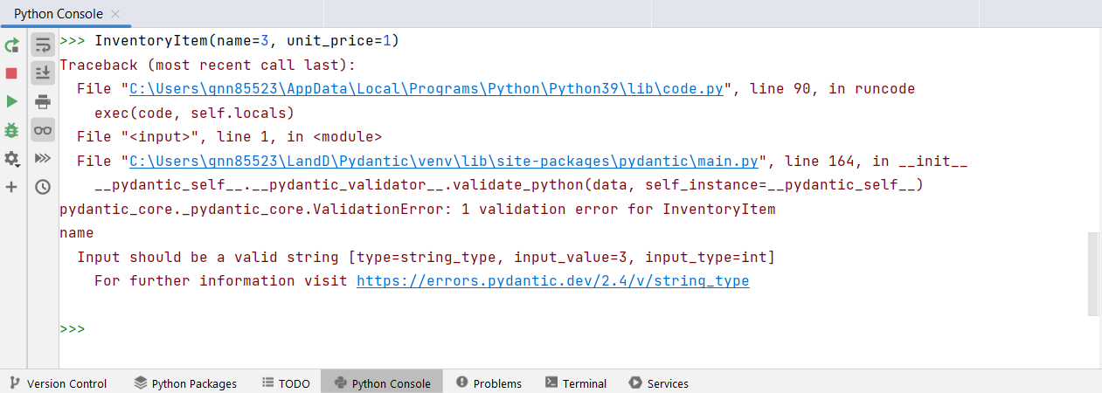
Pydantic

Slide 19

Napoleon
“The English are a nation of shopkeepers”
Thought to have been attributed to Napoleon rather than originating from him
It seems like software developers are a group of shopkeepers as well . . .
Notes:
Please remove or amend the image credit if you are using a different image to the one provided.

Slide 20
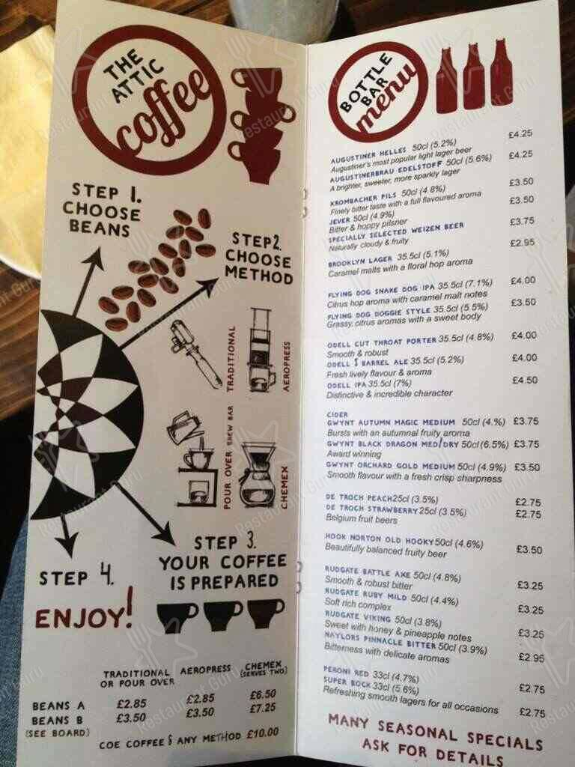
Pydantic Shopkeepers
Let’s run a coffee shop!
Construct a Pydantic model (inherit from BaseModel) for a coffee order.
Use the fields: country (str), method (str), size (str), milk (bool), cream (bool), sugars (int) with appropriate defaults.
Image ©Restaurant Guru
Notes:
Please remove or amend the image credit if you are using a different image to the one provided.

Slide 21
Pydantic Shopkeepers
Try some inputs, for example:
>> Coffee(country=“Brazil”, milk=False, sugars=0)
>> Coffee(cream=“some”, sugars=“none”)
>> Coffee(method=“pour over”, sugars=“1”)
>> Coffee(size=“small”, milk=“yes”, sugars=1.0)
>> Coffee(country=“Wakanda”, milk=+1, sugars=-1)
What do you notice?
Image ©Restaurant Guru
Notes:
Please remove or amend the image credit if you are using a different image to the one provided.

Slide 22
Basic Models
Pydantic gives a list of errors – specifically pydantic.ValidationError
Some unusual inputs are accepted – Pydantic “coerces” inputs to the right type, e.g., float converted to int and vice versa, “yes” (or “y”) is a synonym of True etc. https://docs.pydantic.dev/latest/api/standard_library_types/
Some valid but not sensible inputs are accepted – the fictional country of Wakanda, a negative amount of sugar.
We need to further constrain the fields of our model.

Slide 23
Restricting Strings
We can use typing.Literal to specify an allowed set of options for a field.
from pydantic import BaseModel from typing import Literal class Coffee(BaseModel): """Processes a coffee order at the Sharp Coffee Residence.""" country: Literal["Tanzania", "Ethiopia", "Angola"] = "Angola" ...

Slide 24
Restricting Strings
Alternatively, we can define an Enum:
from pydantic import BaseModel try: from enum import StrEnum except ImportError: from strenum import StrEnum class Countries(StrEnum): Tanzania = 'Tanzania' Ethiopia = 'Ethiopia' Angola = 'Angola' class Coffee(BaseModel): """Processes a coffee order at the Sharp Coffee Residence.""" country: Countries = Countries.Angola

Slide 25
Literal or Enum?
Both options do the job we want.
The advantage of typing.Literal over Enums is performance - ~3x faster.
The advantage of Enums over typing.Literal is reusability between different Pydantic models and elsewhere in the code.
Use whichever is best for your purpose.

Slide 26
Field Function
The field function allows for further customisation and validation.
https://docs.pydantic.dev/latest/concepts/fields/
The basic syntax is:
from pydantic import BaseModel, Field import datetime current_year = datetime.date.today().year class User(BaseModel): name: str = Field(default='John Doe', min_length=1) age: int = Field(..., ge=0) birth_year: int = Field(..., le=current_year)

Slide 27
Field Function – Keyword Arguments
The field function allows for further validation.
For numeric fields:
gt - greater than
lt - less than
ge - greater than or equal to
le - less than or equal to
multiple_of - a multiple of the given number
allow_inf_nan - allow 'inf', '-inf', 'nan' values

Slide 28
Field Function – Keyword Arguments
The field function allows for further validation.
For string fields:
min_length - Minimum length of the string
max_length - Maximum length of the string
pattern - A regular expression that the string must match
The min_length and max_length arguments are also useful for fields that require list input.

Slide 29
Field Function – Keyword Arguments
The field function allows for further validation.
For decimal fields:
max_digits - Maximum number of digits within the decimal.
decimal_places - Maximum number of decimal places.

Slide 30
Field Validators
Field validators are user-written functions that enable further validation for one or more fields.
Field validators are class methods rather than instance methods.
A field validator should either return the field or raise a ValueError or AssertionError (which can be with an assert statement).
A field validator can be used on one or more fields.

Slide 31
Field Validators
We will focus on “after” validators, which use the following syntax:
from pydantic import BaseModel, Field, field_validator class User(BaseModel): name: str = Field(default='John Doe', min_length=1) age: int = Field(..., ge=0) birth_year: int = Field(..., le=current_year) @field_validator('name') @classmethod def name_must_contain_space(cls, field: str) -> str: if ' ' not in field: raise ValueError('Name must contain a space') return field

Slide 32
Annotated Validators
Annotated validators have similar functionality to field validators but allow for greater reusability between Pydantic models.
They use typing.Annotated to apply a validator to a type.
In particular, they can be used to define custom types which Pydantic can validate against.
Further details about custom types in Python are set out in PEP 593: https://peps.python.org/pep-0593/

Slide 33
Annotated Validators
from pydantic import BaseModel, Field from pydantic.functional_validators import AfterValidator from typing import Annotated def name_must_contain_space(field: str) -> str: if ' ' not in field: raise ValueError('Name must contain a space') return field str_with_space = Annotated[str, AfterValidator(name_must_contain_space)] class User(BaseModel): name: str_with_space = Field(default='John Doe', min_length=1) age: int = Field(..., ge=0) birth_year: int = Field(..., le=current_year)

Slide 34
Model Validators
Model validators are like field validators, but apply to the whole model, and are executed when all of the fields have been validated and the model constructed.
They are usually used to resolve the dependence of one field on another.
We will focus on “after” validators, which use the following syntax:

Slide 35
Model Validators
from pydantic import BaseModel, Field, model_validator import datetime current_year = datetime.date.today().year class User(BaseModel): name: str = Field(default='John Doe', min_length=1) age: int = Field(..., ge=0) birth_year: int = Field(..., le=current_year) @model_validator(mode='after') def check_birth_year_matches_age(self) -> 'User': if (self.birth_year != (current_year - self.age) and self.birth_year != (current_year - self.age - 1) ): raise ValueError('Age does not match birth year') return self

Slide 36
Coffee Validation
Use the Field function to ensure we cannot have a negative amount of sugar.
Use the Literal/Enums to define a set of countries, the coffee methods (traditional, aeropress, pour over and chemex) and sizes
If the mood takes you . . . come up with some custom names for coffee sizes.
Image ©Restaurant Guru

Slide 37
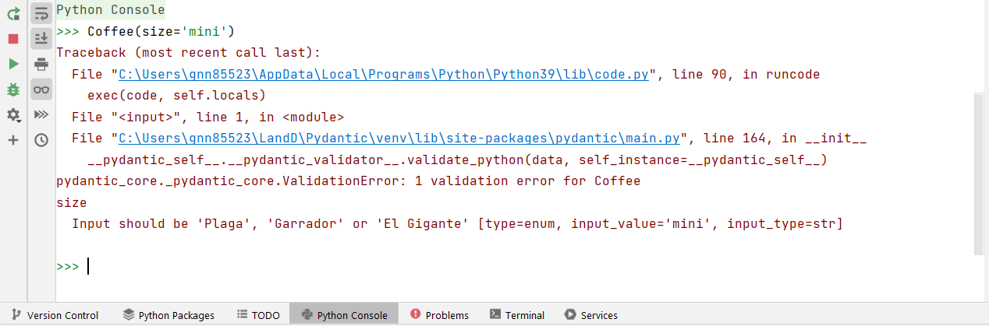
Coffee Size

Slide 38
Coffee Validation
Use validators to make sure that:
we can’t have milk and cream together,
we can only have an odd number of sugars (or zero),
the chemex method is only available for the largest size coffee.
Extra: Create a UUID for an order number field. What’s the default? How do we prevent it from being changed . . .
Image ©Restaurant Guru

Slide 39
Model Config
The model_config is a dictionary of options that apply to the model.
The model_config controls the behaviour of the entire model, and can be used to apply some options in the Field function throughout.
When inheriting a pydantic model, the config is also inherited, with any additional config options merged in.

Slide 40
Model Config
from pydantic import BaseModel, ConfigDict class User(BaseModel): model_config = ConfigDict(str_max_length=10) name: str = Field(default='John Doe', min_length=1) ...
from pydantic import BaseModel class User(BaseModel, str_max_length=10): name: str = Field(default='John Doe', min_length=1) ...

Slide 41
Model Config
The config options are listed here: https://docs.pydantic.dev/latest/api/config/
There are two options I have found particularly useful:
validate_assignment
extra

Slide 42
Validate Assignment
When True, validate_assignment revalidates the model when any of the fields are changed (by assignment, NOT by mutation).
This is very useful, and ensures models remain defined as intended throughout their lifetime.
However, this can cause problems . . .

Slide 43
Validate Assignment
from pydantic import BaseModel class User(BaseModel, validate_assignment=True): name: str = "" msgs: list[str] = [] initial_copies: int = 2 @model_validator(mode='after') def make_copies(self) -> 'User': self.msg *= self.initial_copies return self

Slide 44
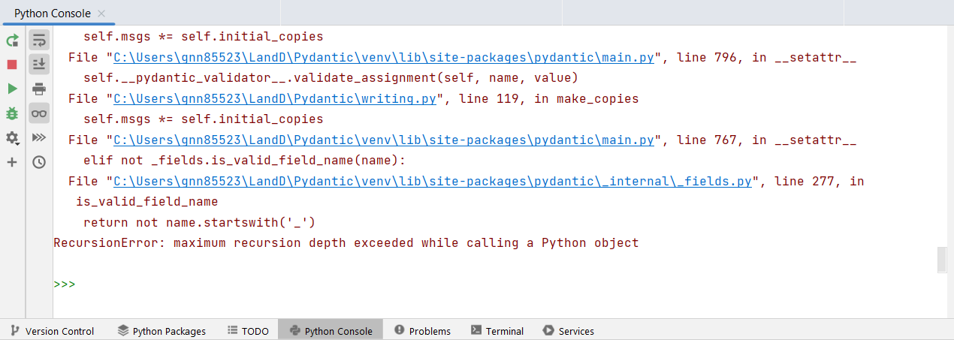
Validate Assignment

Slide 45
Validate Assignment
from pydantic import BaseModel class User(BaseModel, validate_assignment=True): name: str = "" msgs: list[str] = [] initial_copies: int = 2 @model_validator(mode='after') def make_copies(self) -> 'User': orig_list = self.msgs for i in range(1, self.initial_copies): self.msgs.extend(orig_list) return self

Slide 46
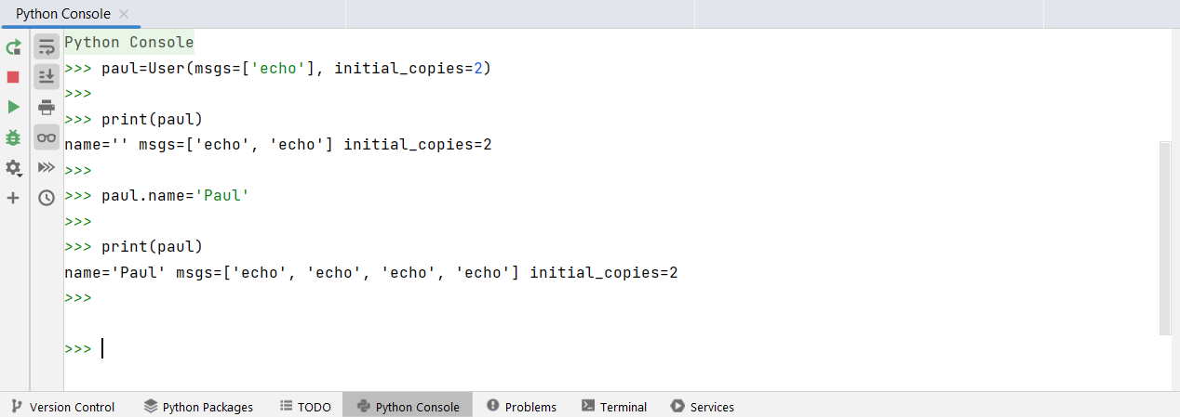
Validate Assignment

Slide 47
Validate Assignment
To avoid these problems, we need to think carefully about what we do inside validators.
One solution is to make changes by mutation rather than assignment where possible.
We can also use the model_post_init routine to modify the model prior to model validation.
https://docs.pydantic.dev/latest/api/base_model/#pydantic.main.BaseModel.model_post_init

Slide 48
Model Post Init
from pydantic import BaseModel from typing import Any class User(BaseModel, validate_assignment=True): name: str = "" msgs: list[str] = [] initial_copies: int = 2 def model_post_init(self, __context: Any) -> None: orig_list = self.msgs for i in range(1, self.initial_copies): self.msgs.extend(orig_list)

Slide 49
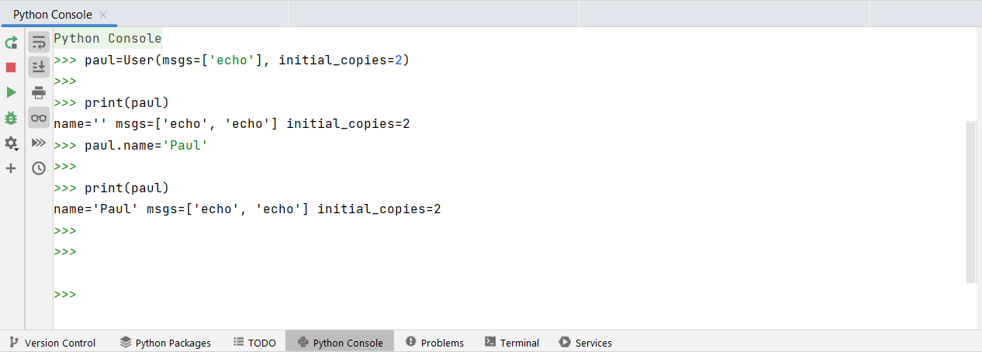
Model Post Init

Slide 50
Extra Fields
What happens when we include undefined fields in the model initialisation?
It depends on the value of extra in the model_config
allow – Include any extra attributes in the model
forbid – Forbid any extra attributes, raise an error if any are included
ignore – Ignore any extra attributes (default)
If extra=“allow”, then the extra fields are listed in the model_extra attribute of the model.

Slide 51
Extra Fields
from pydantic import BaseModel, ConfigDict class User(BaseModel): model_config = ConfigDict(extra='ignore') name: str user = User(name='John Doe', age=20) print(user) #> name='John Doe'

Slide 52
Extra Fields
from pydantic import BaseModel, ConfigDict class User(BaseModel): model_config = ConfigDict(extra='allow') name: str user = User(name='John Doe', age=20) print(user) #> name='John Doe' age=20

Slide 53
Extra Fields
from pydantic import BaseModel, ConfigDict, ValidationError class User(BaseModel): model_config = ConfigDict(extra='forbid') name: str try: User(name='John Doe', age=20) except ValidationError as e: print(e) ''' 1 validation error for User age Extra inputs are not permitted [type=extra_forbidden, input_value=20, input_type=int] '''

Slide 54
Free Play
Try using the model_config – set validate_assignment to True and see what happens as you change the fields. How should you set extra?
Include a model for Tea alongside Coffee – think about an appropriate inheritance structure.
Include hot chocolate – make a list of toppings with some validation.
The methods of making coffee will themselves have options to choose from – try splitting them out into individual models and selecting them from the Coffee model using a discriminated union https://docs.pydantic.dev/latest/concepts/unions/#discriminated-unions.

Slide 55
Free Play
Add a water field to the Coffee model, using the pint library (https://pint.readthedocs.io/en/stable/) to ensure a particular volume of water is specified. What validators are needed here?
- You’ll need to include arbitrary_types_allowed=True in the model_config here.
. . . And anything else you can come up with!

Slide 56
Links
Pydantic: https://docs.pydantic.dev/latest/
ISIS: https://www.isis.stfc.ac.uk/Pages/home.aspx
Typing module: https://docs.python.org/3/library/typing.html
Pint: https://pint.readthedocs.io/en/stable/
Migration Guide: https://docs.pydantic.dev/2.0/migration/
Coercion: https://docs.pydantic.dev/latest/api/standard_library_types/
Fields: https://docs.pydantic.dev/latest/concepts/fields/
Validators: https://docs.pydantic.dev/latest/concepts/validators/
Model Config: https://docs.pydantic.dev/latest/api/config/

